Slide 1

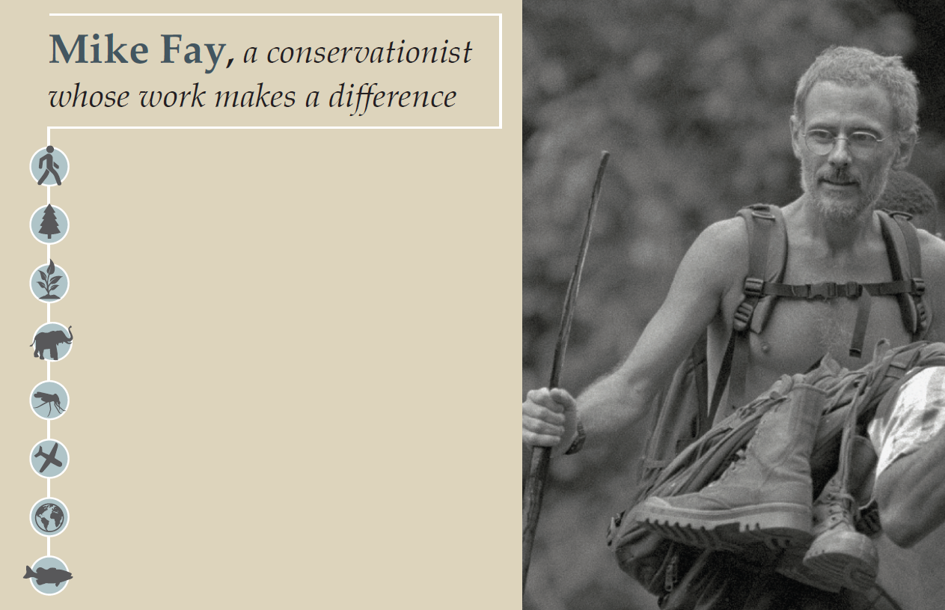
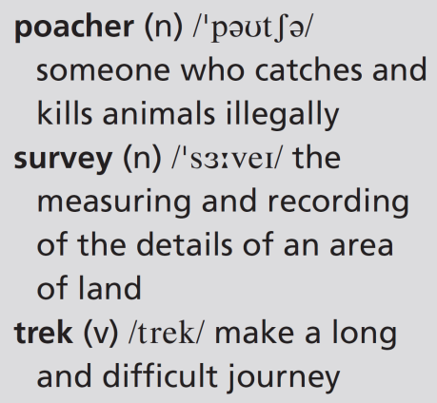
8b Walking for wildlife
trekked 10,000 kilometres in Africa and North America
counted giant redwood trees in North America, elephant populations in central Africa
created 13 national parks in Gabon
protected thousands of elephants from poachers
survived a malaria attack, an elephant attack, a plane crash
flown over the African continent for an aerial survey
uploaded thousands of photos to Google Earth
helped to create a marine park off the Gabon coast
8b-p. 96

Slide 2
Listening
1 What kind of work does a conservationist do? What is their main aim?
A conservationist is somebody whose job involves trying to protect natural environments. Conservationists might campaign to stop people or companies from cutting down trees, killing wildlife or polluting water supplies. They might work to stop plants or animals from going extinct.
2 Look at the information about Mike Fay. Do you think he’s a typical conservationist? Why? / Why not?
probably not, because he’s trekked 10,000 kilometres and has had some dangerous/exciting experiences.
8b-p. 96

Slide 3

3 Listen to an extract from a radio programme about Mike Fay. Complete the sentences.
Track 65
1 Mike Fay’s work is about saving the last ________________ on Earth.
2 He’s spent a total of more than ________________ years of his life on treks.
3 His usual luggage is a T-shirt, a pair of shorts and a ________________.
4 He’s walked in Africa, the United States and ________________.
5 He’s worried about how ________________ people will affect the planet.
wild places
two
pair of sandals
Canada
seven billion
8b-p. 96

Slide 4
4 Listen to the extract again and choose the correct option to complete the sentences.
Track 65
Track 65
1 Recently, Fay has been flying / walking across Canada.
2 Mining companies have been looking for / producing gold and oil.
3 Mining companies have been digging up / destroying vast areas.
4 In Gabon, people have been asking / trying to set up mines near parks.
5 Work in pairs. Would you like to spend a year working with Mike Fay? Why? / Why not?
Students’ own ideas
8b-p. 96

Slide 5
Script
Track 65
Track 65
When you’ve walked across half of Africa and you’ve walked up the west coast of North America, where do you go next? On tomorrow’s show my guest is a man who can give us the answer.
I’m talking about the conservationist Mike Fay – a man with a very personal way of saving what he calls the last wild places on Earth. For those of you who don’t know Mike Fay, he does some unusual things in his work with the Wildlife Conservation Society. For instance, he’s spent more than two years of his life trekking through some of the toughest places on the planet. And he often just takes a T-shirt, a pair of shorts and a pair of sandals on these treks. Fay says he has only slept in a bed about fifty times in ten years. The last time he was on the show, he’d just finished a survey of giant redwood trees on the west coast of the United States. What has he been doing since then? Well, he hasn’t been taking it easy! In fact, recently he’s been walking again, this time across Canada. In western Canada, mining companies have been looking for gold and oil. To do this, they’ve been digging up enormous areas – they’ve destroyed hundreds of square kilometres of wilderness. You can hear what Mike Fay feels about this in tomorrow’s show. And we’ll also find out what’s been happening to national parks in Gabon since Fay was there. We know that people have been trying to set up mines near the parks and the Gabonese government has stopped at least two mining operations. Hear more tomorrow in my interview with Mike Fay, and find out what he thinks a population of seven billion people might do to our planet.

Slide 6
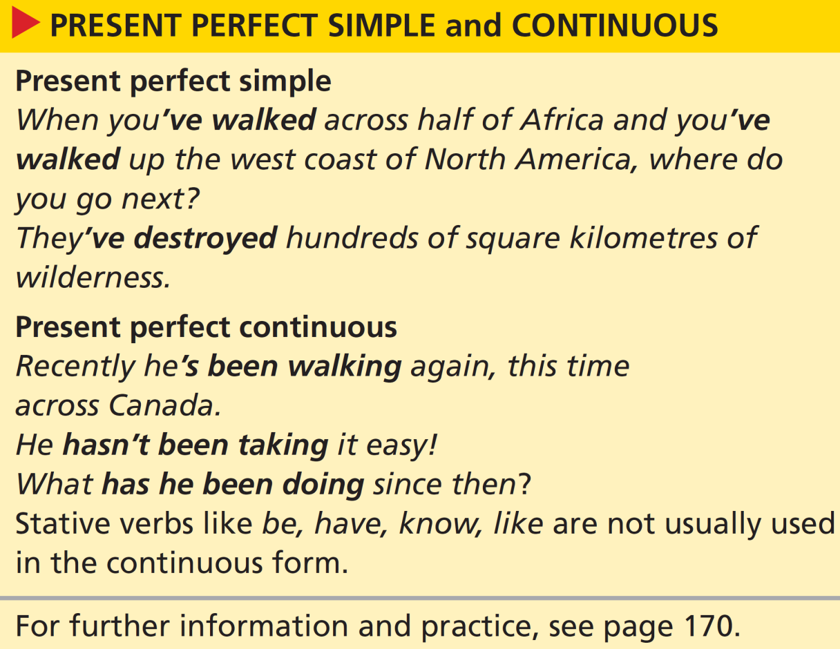

Grammar present perfect simple and continuous
6 Look at the grammar box. Answer the questions.
1 How do we form the present perfect simple? How do we form the present perfect continuous?
2 Which verb form emphasizes the duration or repetition of an activity? Which verb form emphasizes an action or an activity that is complete?
1 present perfect simple: has/have + past participle of main verb
present perfect continuous: has/have + been + -ing form of main verb
2 The present perfect expresses completion and result.
The present perfect continuous expresses repeated activity.
8b-p. 97

Slide 7
7 Complete the text with the present perfect simple and present perfect continuous form of the verbs.
This year, Mike Fay 1 _______________________________ (work) in Gabon. He 2 _______________________________ (check) the situation in the national parks and he 3 _______________________________ (discover) some problems. For example, poachers 4 ____________________________ (kill) elephants again. Fay 5 _______________________________ (talk) about ways of controlling poaching with the Gabonese government. As a result, the Gabonese president 6 _______________________________ (send) soldiers to several of the parks. So far, the poachers 7 ___________________________ (not / return). Meanwhile, for the past few years, foreign ships 8 ____________________________ (fish) in the marine park. The Gabonese government 9 ___________________________ (try) to find ways of dealing with this problem.
has been working
has been checking / has checked
has discovered
have been killing
has been talking / has talked
has sent
haven’t returned
have been fishing
have been trying
8b-p. 97

Slide 8
8 Write questions for Mike Fay with the present perfect simple and present perfect continuous form of the verbs.
1 What / you / do / recently?
2 you / prepare for / any new trips?
3 How / you / feel / since the plane crash?
4 How many photos / you / take / in your career?
5 How long / you / travel / alone?
6 you / be / anywhere dangerous lately?
1 What have you been doing recently?
2 Have you been preparing for any new trips?
3 How have you been feeling since the plane crash?
4 How many photos have you taken in your career?
5 How long have you been travelling alone?
6 Have you been anywhere dangerous lately?
8b-p. 97

Slide 9
9 Match the travel preparation activities (1–6) with the results (a–f). Then write two sentences.
I’ve been buying holiday clothes. I’ve spent a fortune.
b
f
a
e
c
d
1 buy holiday clothes
2 look for cheap flights
3 talk to travel agents
4 download tourist information
5 pack my suitcase
6 practise useful phrases in Thai
1 (see example)
2 (I’ve been looking for cheap flights. I haven’t found any.)
3 (I’ve been talking to travel agents. I’ve been on the phone all morning.)
4 (I’ve been downloading tourist information. I’ve printed a couple of pages.)
a be on the phone all morning
b spend a fortune
c run out of space
d not learn many
e print a couple of pages
f not find any
5 (I’ve been packing my suitcase. I’ve run out of space.)
6 (I’ve been practising useful phrases in Thai. I haven’t learnt/learned many.)
8b-p. 97

Slide 10
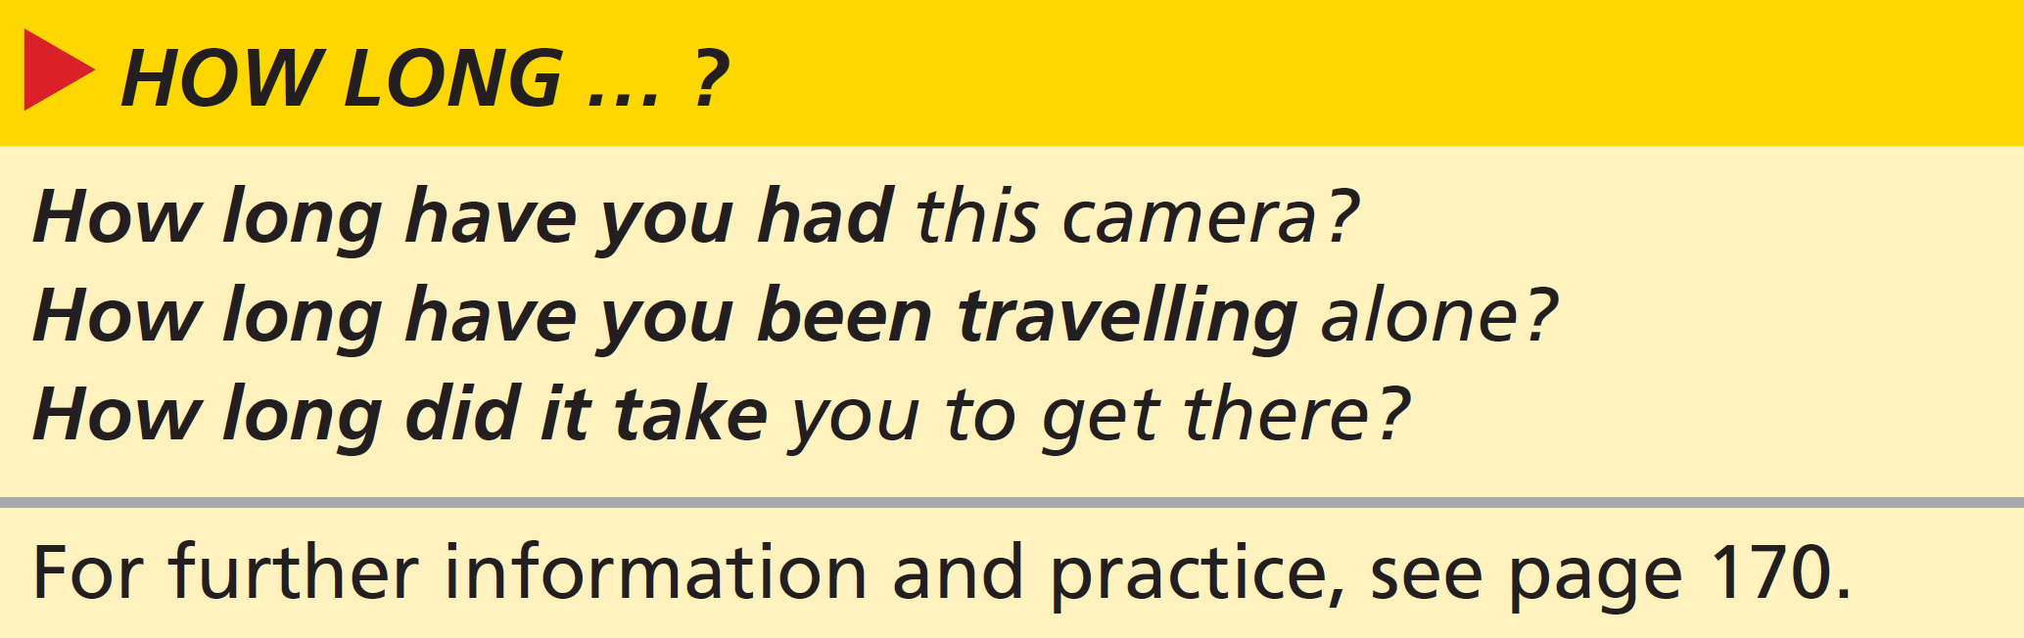
Grammar How long … ?
10 Look at the grammar box. Which verb form is used in each question? Why?
1 How long have you had this camera? = present perfect simple because it’s incomplete but uses a state verb
2 How long have you been travelling alone? = present perfect continuous because it’s an incomplete action which is repeated and has duration
3 How long did it take you? = past simple because it’s a finished past action
8b-p. 97

Slide 11
11 Match the questions (1–6) with the answers (a–e). Then work in pairs and continue the conversations.
1 How long have you been coming to this resort?
2 How long did the flight from London take?
3 How long have you known each other?
4 How long did you spend in Canada?
5 How long have you been waiting for the bus?
6 How long have you been here?
b
a
d
c
e
f
Example
A: How long have you known each other?
B: Not long – we met on holiday this spring.
A: Really? Where did you meet?
B: On holiday. We were both on the same tour bus.
a About ten hours non-stop.
b For the last four or five years.
c I was there for a couple of months.
d Not long – we met on holiday this spring.
e Only a few minutes. But I think we just missed one.
f We arrived yesterday morning.
A: How long have you been coming to this resort?
B: For the last four or five years.
A: Has it changed a lot in that time?
8b-p. 97

Slide 12

Speaking
12 What kinds of activities are you interested in? How long have you been doing them? Work in pairs and tell your partner. Ask follow-up questions. Use some of these ideas.
I’ve been … since/for …
I took it up when …
I’ve always/never …
In the last few … , I’ve …
EXAMPLE ANSWERS
I’ve been interested in stamp collecting / birdwatching since 2012 / for ten years.
I took it up when I left home / my wife left me.
I’ve always/never loved working with my hands.
In the last few years, I’ve found some rare Zambian stamps.
8b-p.97

Slide 13
8c All aboard!
Reading
EXAMPLE ANSWERS
1/2 Students’ own answers
1 Work in pairs. Discuss the questions.
1 Do many tourists come to your country or region? From which countries?
2 What do these tourists do? Activity holidays, backpacking, cultural sightseeing, ecotourism, or other holiday activities?
3 What are the advantages of this tourism? Are there any disadvantages?
3 Advantages: provides money and jobs for local people; makes sure places are protected; puts a place on the map – promotes a country in a positive way; improves local infrastructure; makes the place more lively with shops and restaurants and bars; an opportunity to meet people from different cultures
Disadvantages: overcrowding; pollution; too much development and construction; natural places can be spoilt; prices, particularly house prices, can affect local people; some tourists can be noisy or thoughtless
8c-p. 98

Slide 14
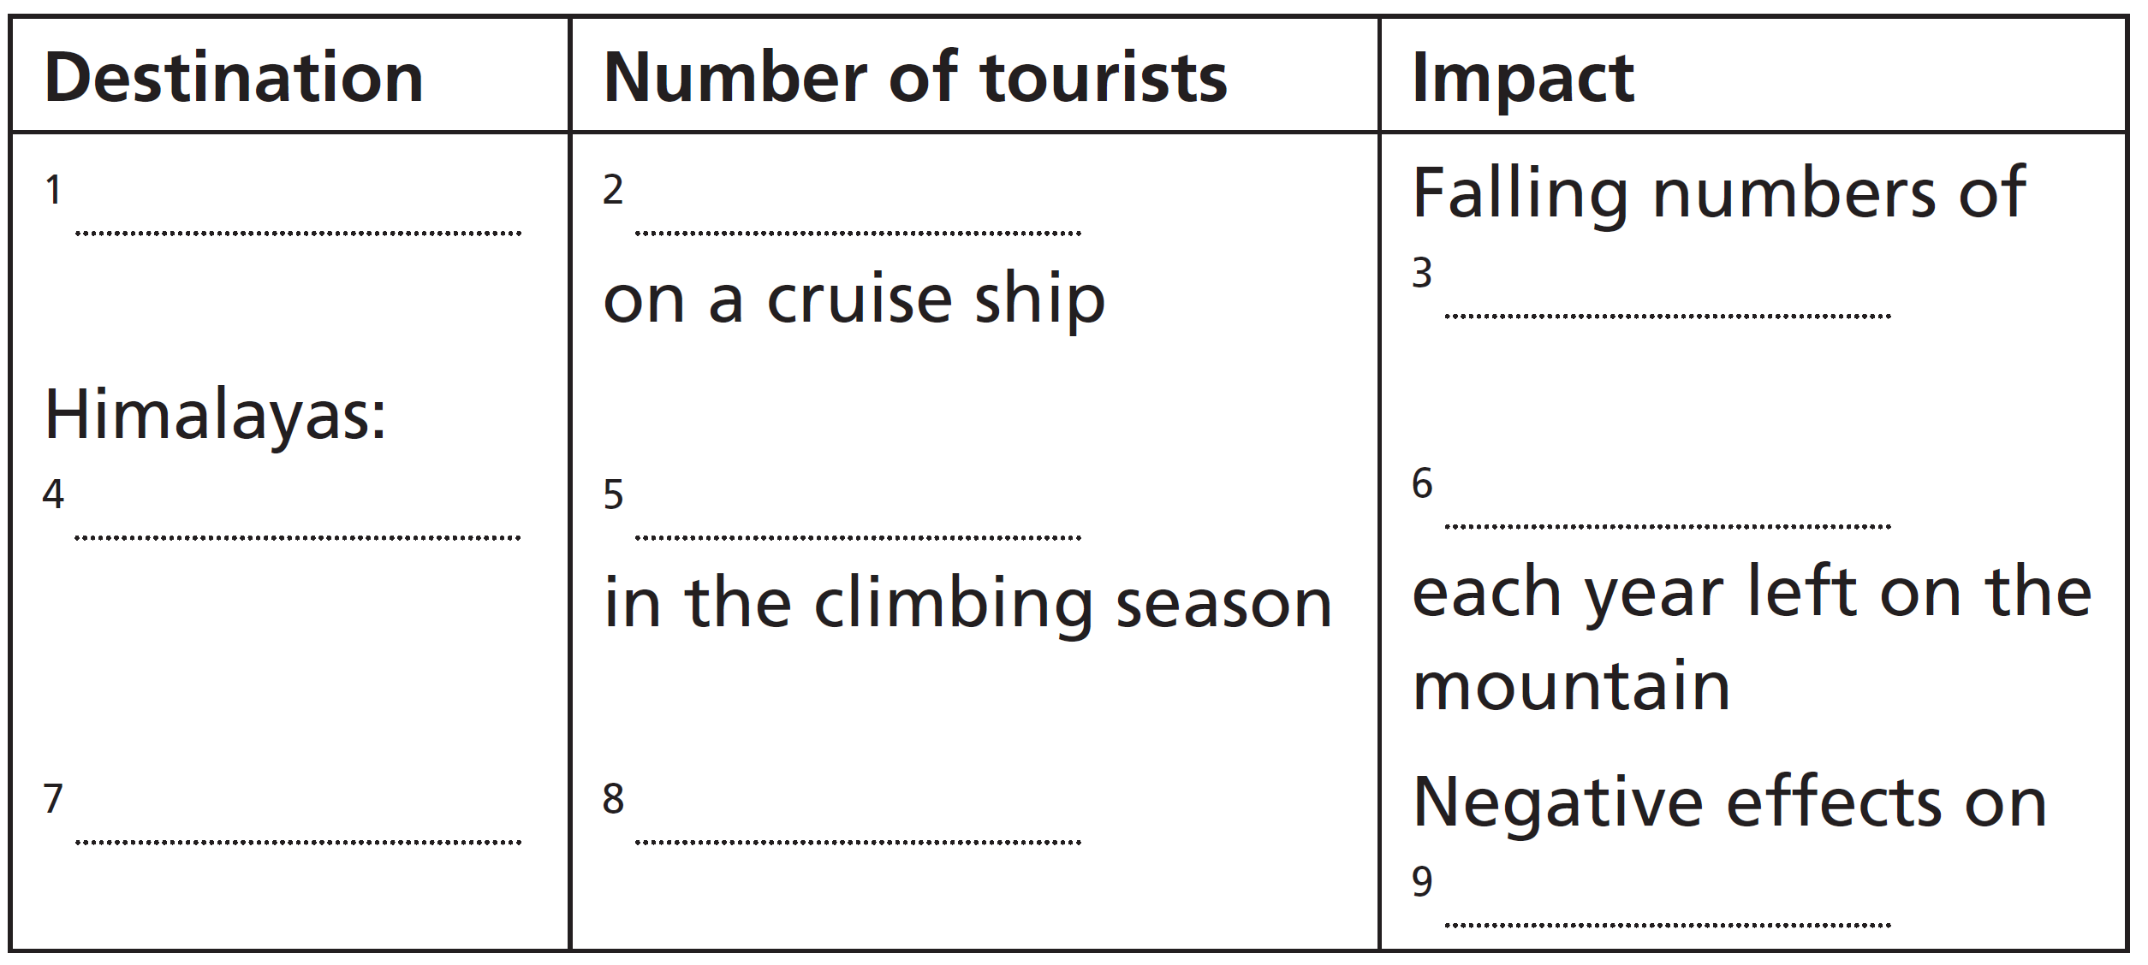
2 Read the article quickly. What is it about? Choose the best option (a–c).
a It describes extreme activities tourists can do.
b It compares the positive and negative effects of tourism.
c It talks about the impact of lots of tourists on a destination.
3 Read the article again and complete the table.
8c-p. 98

Slide 15
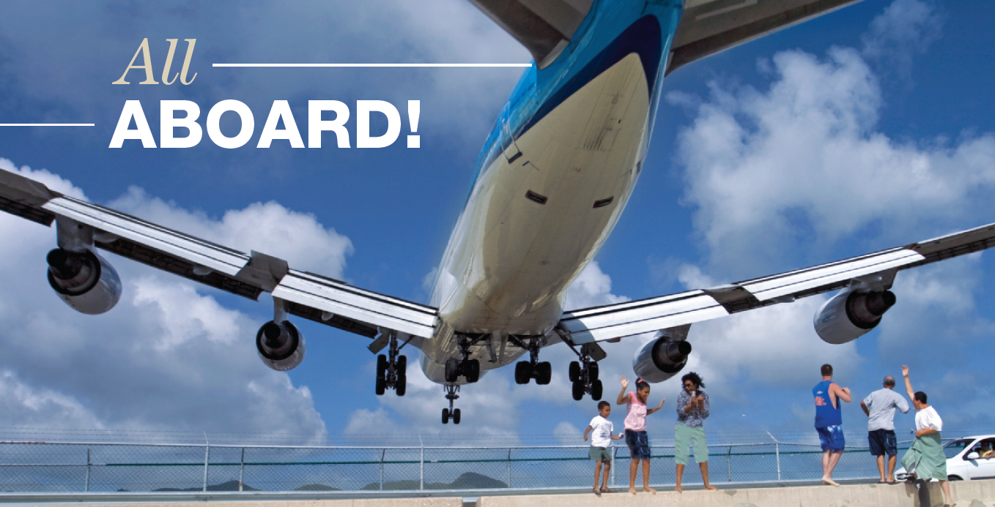
A plane comes in to land on the
Caribbean island of Saint Martin.
Track 66
The tourism industry started to grow rapidly in the middle of the last century and it’s been growing ever since. In the last twenty years especially, more and more people have been travelling to distant places around the world. It’s a wonderful thing, to be able to travel to destinations we had previously only read about or seen on television. But what kind of impact do large numbers of people have on these places?
8c-p. 99

Slide 16
Track 66
A voyage to the end of the Earth?
A large cruise ship can carry as many as six thousand passengers at a time, with about twenty-four million people going on cruises every year. Cruise ships drop about ninety thousand tons of waste into the oceans every year and each ship produces as much air pollution as five million cars. he effects of this are made even worse by the fact that cruises visit the same places over and over again, so the damage is repeated. In Patagonia, this has been having an effect on wildlife. The numbers of Magellanic penguins have been falling for some years now, for example.
Climbing to the top of the world
Far fewer people go climbing or trekking in the Himalayas than take a cruise, but in the short climbing season each May about a thousand people try to climb Everest. At times, there are actually queues of climbers on the route to the top. The difficult conditions mean that everyone needs to take a lot of equipment with them. Unfortunately, for the last few decades, climbers have been leaving their equipment on Everest. In recent years, clean-up teams have been organizing expeditions just to pick up this rubbish. The teams are made up of local and international climbers. One group has brought over eight tons of rubbish down from the mountain!
8c-p. 99

Slide 17

Track 66
Let’s all go to the beach
What happens when a region of about a million people is visited by thirteen million tourists every year? The Balearic Islands in the Mediterranean Sea have been dealing with this situation for decades. Where has the fresh water, the food, the petrol and the electricity for thirteen million tourists come from? And how have the islands maintained the quality of the beaches, the roads and the countryside? Recently, the government of the Balearic Islands decided to charge tourists an ecotax of two euros a day. This has been tried once before, but it wasn’t a success. However, the challenges have been getting harder every year. The money from the tax is used to reduce the negative effects of tourism on the local environment.
Difficult choices
So, should we travel or simply stay at home? Many destinations offer low-impact tourism such as ecotourism. It’s time to ask ourselves some difficult questions. Can we really visit the world’s beautiful places without destroying them?
8c-p. 99

Slide 18
2 Read the article quickly. What is it about? Choose the best option (a–c).
a It describes extreme activities tourists can do.
b It compares the positive and negative effects of tourism.
c It talks about the impact of lots of tourists on a destination.
3 Read the article again and complete the table.
Patagonia
6,000
Magellanic penguins
Everest
about a thousand
rubbish
Balearic islands
thirteen million
(the) local environment
8c-p. 98

Slide 19
4 Answer the questions with information from the article.
1 When did the tourism industry start to be successful?
2 Why are cruises bad for the environment? Find three reasons.
3 What have groups been doing to improve the environment on Everest?
4 What action has the government of the Balearic Islands taken, and why?
1 in the middle of the last century
2 Cruise ships drop about 90,000 tons of waste into the oceans every year; each ship produces as much air pollution as five million cars; cruises visit the same places over and over again, so the damage is repeated.
3 Clean-up teams have been organizing expeditions to pick up the rubbish left on Everest.
4 The government of the Balearic Islands has decided to charge tourists an eco-tax of two euros a day to maintain the quality of the beaches, the roads and the countryside.
8c-p. 98

Slide 20
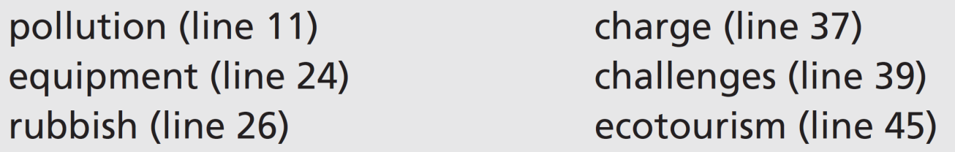
5 Find these words in the article. Look at how the words are used and try to guess their meaning. Then complete the sentences (1–6).
1 Airlines usually ______________ you a lot of money if your luggage is over the weight limit.
2 On average, each person in the UK produces about 500 kg of ______________ each year.
3 I don’t have much kitchen ______________ – just a microwave.
4 Speaking a new language can be one of the hardest ______________ when you travel abroad.
5 ______________ is a way of enjoying a holiday without damaging the environment.
6 Plastic is a major cause of ______________ in the oceans.
charge
rubbish
equipment
challenges
Ecotourism
pollution
8c-p. 98

Slide 21
Critical thinking close reading
6 According to the article, are these statements true (T) or false (F)? Or is there not enough information (N) in the article to say if the statements are true or false?
F
T
N
N
N
1 The tourism industry has grown steadily and has now reached its peak.
2 There are fewer Magellanic penguins since cruises started visiting Patagonia.
3 Climbers on Everest cause problems for the local population.
4 There’s not enough fresh water in the Balearic Islands in the holiday season.
5 It’s better to stay at home than be an ecotourist.
7 Work in pairs. Underline the sections of the article that helped you decide about the sentences in Exercise 6. Do you agree with each other?
See next slide for answers
8c-p. 98

Slide 22
Exercise 7
1 F: The tourism industry started to grow rapidly in the middle of the last century and it’s been growing ever since. (i.e. it hasn’t yet reached its peak)
2 T: In Patagonia, this (repeat visits by cruise ships) has been having an effect on wildlife. The numbers of Magellanic penguins have been falling for some years now, for example.
3 N: (There is no mention of how or whether the local population is affected in the text.)
4 N: (The text asks where the fresh water has to come from, but doesn’t say whether there is enough or not.)
5 N: (The text suggests that being an ecotourist is a good thing but doesn’t say whether it’s better or worse than staying at home.)

Slide 23
8 Work as a class. Discuss the questions.
1 Do you think an eco-tax on tourists is a good idea?
2 What is your answer to the final question in the article?
EXAMPLE ANSWERS
1 Students’ own ideas. An eco-tax might be good because it will raise money to protect the environment, make tourists more aware that they are having an impact on the environment, and potentially reduce the number of tourists.
2 Students’ own ideas
8c-p. 98

Slide 24
Speaking
9 Work in pairs. Look at these activities. Decide if they have a good or bad impact on the environment. Which ones does your family do?
EXAMPLE ANSWERS
1 flying to distant holiday destinations
2 recycling household waste (paper, glass, organic waste)
3 travelling by car
4 switching off lights and electrical appliances
5 saving water (turning off taps, not watering the garden)
6 using eco-friendly cleaning products
Flying to distant holiday destinations leaves a big carbon footprint – a lot of fuel is used and a lot of carbon dioxide and other pollutants are released.
Recycling household waste (paper, glass, organic waste, etc.) is good because it saves trees and other raw materials and avoids the dumping of materials.
Travelling by car uses petrol – a fossil fuel – which causes pollution and is therefore bad for the environment.
Switching off lights and electrical appliances saves electricity – it’s good for saving natural resources.
Saving water (turning off taps, not watering the garden) is good for the environment.
Using eco-friendly cleaning products is good because they avoid chemicals and other pollutants that can harm wildlife.
8c-p. 98

Slide 25
10 Work in groups. How easy is it for you and your family to live a green lifestyle?
A: We’ve been recycling paper for years. It’s not hard to remember to do if you have a special box for it.
B: We do that too.
8c-p. 98

Slide 26
8e Hello from London!
Writing a text message
1 Read the message from Lynne. Answer the questions.
1 Where has Lynne come from and where is she now?
2 Who do you think the message is for? Friends, family, or both?
3 What does Lynne say about the people and the city?
4 What has she been doing?
8e-p. 101

Slide 27
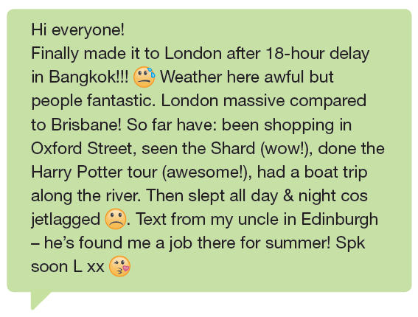

8e-p. 101

Slide 28
8e Hello from London!
Writing a text message
1 Read the message from Lynne. Answer the questions.
1 Where has Lynne come from and where is she now?
2 Who do you think the message is for? Friends, family, or both?
3 What does Lynne say about the people and the city?
4 What has she been doing?
1 has come from Brisbane; is now in London
2 probably friends – because she mentions ‘her uncle’ in Edinburgh (but it could be both)
3 people – fantastic; London – massive
4 she’s been shopping in Oxford Street, seen the Shard, done the Harry Potter tour, had a boat trip along the river
8e-p. 101

Slide 29
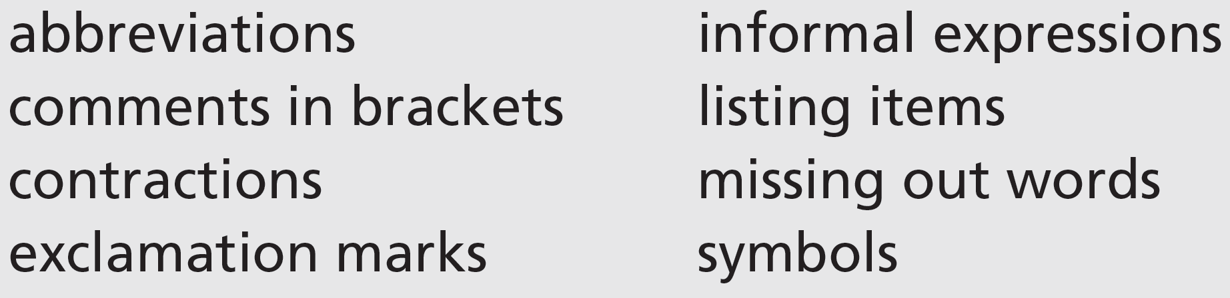
2 Writing skill informal style
a Read the message again. Which of these features of informal style does Lynne use?
Lynne uses all the features in her message:
abbreviations: cos (because); Spk (Speak / Let’s speak / We’ll speak); L (Lynne)
comment in brackets: (wow!); (awesome!)
contractions: he’s
exclamation marks: Bangkok!!!; (wow!); (awesome!); for summer!
informal expressions: Hi; made it; fantastic; awesome
listing items: So far have: been shopping in Oxford Street, seen the Shard (wow!), done the Harry Potter tour (awesome!), had a boat trip along the river.
missing out words: (I) Finally made it; after (an) 18-hour delay; (The) Weather here (is) awful but (the) people (are) fantastic. London (is) massive; So far (I) have; Then (I) slept all day; (I was) jetlagged; (I had a) Text from my uncle in Edinburgh – (he) has found me a job there for (the) summer!
symbols: sweat from forehead face (after ‘Bangkok!!! In line 1); unhappy face (after ‘jetlagged’ and before full stop in line 4); blowing kisses face (after ‘L xx’ at end)
8e-p. 101

Slide 30
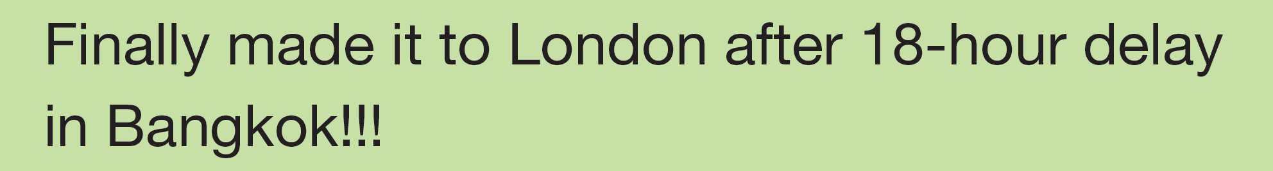
b Look at this extract from the message. The words I and an are missing. Mark their position in the complete sentence.
Finally, I / I finally made it to London after an 18-hour delay in Bangkok!
c Mark the places in the message where Lynne has missed out words. What are the words?
(The) Weather here (is) awful but (the) people (are) fantastic. London (is) massive compared to Brisbane! So far (I) have: been shopping in Oxford Street, seen the Shard (wow!), done the Harry Potter tour (awesome!), (and) had a boat trip along the river. Then (I) slept all day & night cos (I was) jetlagged. (I had a) Text from my uncle in Edinburgh – (he) has found me a job there for (the) summer! Spk (Speak / Let’s speak / We’ll speak) soon L xx
8e-p. 101

Slide 31
d Rewrite the sentences in full.
1 city massive & noisy!
2 not got theatre tickets cos fully booked
3 been visiting Tower of London – scary!
4 took selfies (lots) on Oxford St
5 can’t understand London accent (trying!)
6 text from Jo – arriving Sunday
1 The city is massive and noisy!
2 I haven’t got any theatre tickets because the theatre was fully booked.
3 I've been visiting the Tower of London – it’s scary!
4 I took lots of selfies on Oxford Street.
5 I can’t understand the London accent, though/but I‘m trying (to)! / I‘m trying to understand the London accent, but I can’t.
6 I had a text from Jo – she’s arriving on Sunday.
8e-p. 101

Slide 32
e Rewrite the sentences. Miss out words where possible.
1 The weather is wet and it has been very cold sometimes.
2 I’ve been touring all the typical places – it’s exhausting!
3 The people here are very kind and they have helped me a lot.
4 I took some photos of some pigeons – they’re everywhere!
5 I haven’t heard anything from Anton yet.
6 I’m getting a bus up to Edinburgh because flying is too expensive.
1 Weather wet & very cold.
2 Been touring typical places – exhausting!
3 People here very kind & have helped a lot.
4 Pigeons everywhere! Took photos.
5 Not heard from Anton yet.
6 Getting bus to Edinburgh cos flying expensive.
3 Choose a place you have visited or would like to visit. Make notes. Use the questions in Exercise 1 as a guide.
8e-p. 101

Slide 33
4 Decide who to write to. Write a message of about 75 words describing your trip. Use some of the features of informal style from Exercise 2a and miss out words which are not necessary.
5 Send your message to someone in your class. Then read the message you have received. Use these questions to check your classmate’s message.
• Is everything clearly expressed?
• Are there any sections you do not understand?
6 Work in pairs. Tell your partner about the message you have received.
A: I got a message from Daisuke the other day.
B: Oh! How’s he getting on?
8e-p. 101

